Slide 1
Introduction
The word "ecology" ("oekologie") (coined by German scientist Ernst Haeckel,1866) was derived from the Greek ―oikos” meaning "household" and logos meaning "science:" the "study of the household of nature”
Or
Ecology is the branch of science studying the interaction among living things and their environment
Or
  Ecology is branch of biology concerned with the relations between organisms and their environment
Or
Study of the interaction between living things and their physical , chemical and biological environment
Ecology is not synonymous with environment, environmentalism, or environmental science.
Ecology is closely related to physiology, evolutionary biology, genetics and ethology.
An understanding of how biodiversity affects ecological function is an important focus area in ecological studies.

Slide 2
Ecological systems are studied at several different levels from individuals and populations to ecosystems and biosphere level.
Ecology is a multi-disciplinary science, drawing on many other branches of science.
Applied ecology is the practice of employing ecological principles and understanding to solve real world problems.
For example
calculating fish population,
measuring environmental impact from construction or logging,
building a case for the conservation of a species, and
determining the most effective way to protect a species.

Slide 3
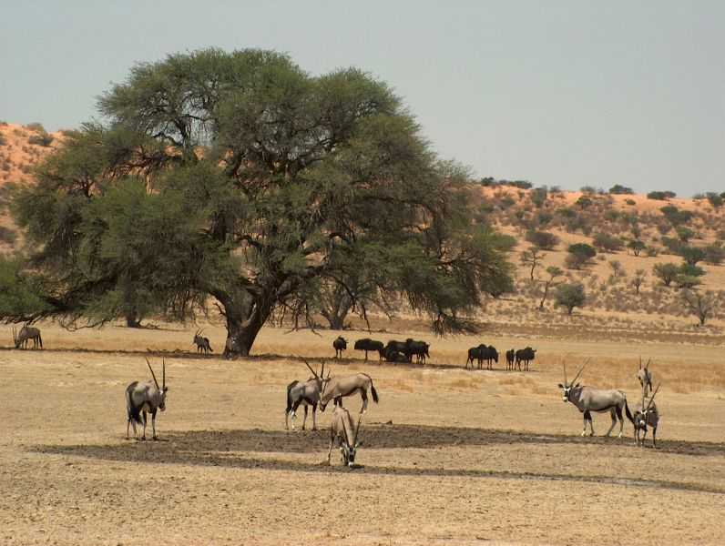
Basic concepts in ecology
An ecosystem
An ecosystem means the collection of life forms, including all organic and inorganic material, in a determined area. An ecosystem is an interactive entity, and its boundaries are not often very clear.
www.nissan4x4.co.za/Gallery/Bongani/Kgalagadi...

Slide 4
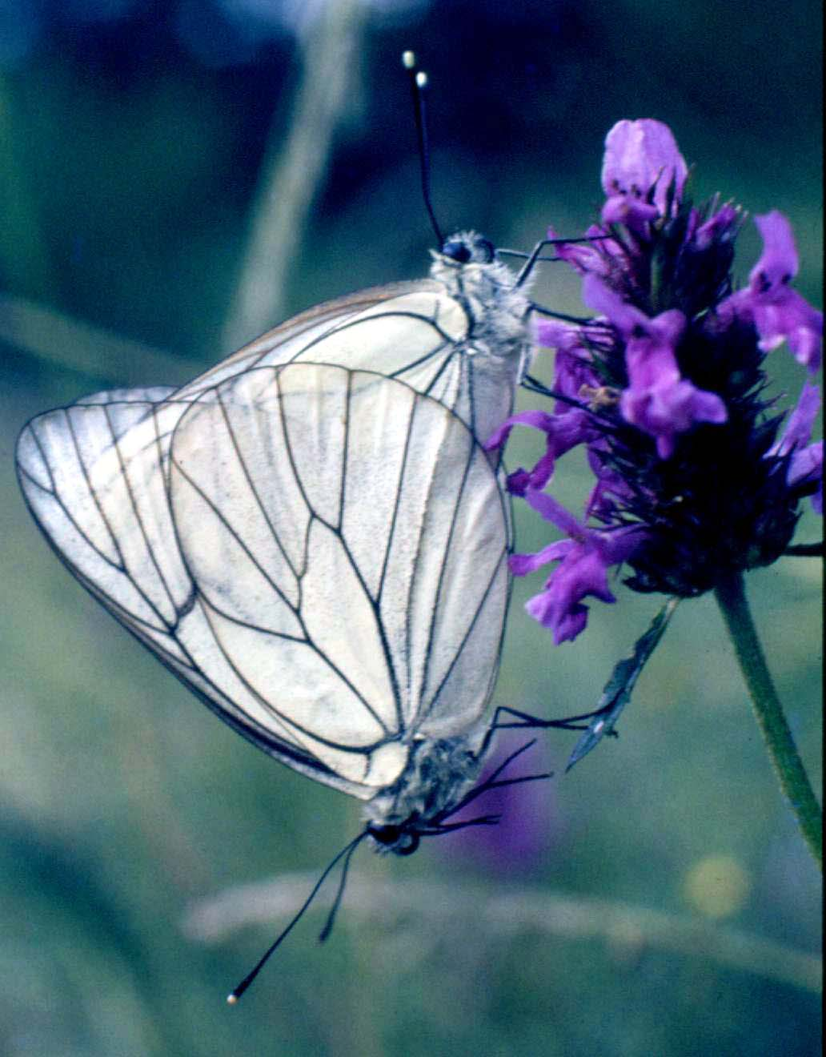
Population
A group of organism of the same species which live in the same habitat at the same time where they can freely interbreed
The black-veined white butterfly(Aporia crataegi) mating
© P Billiet

Slide 5
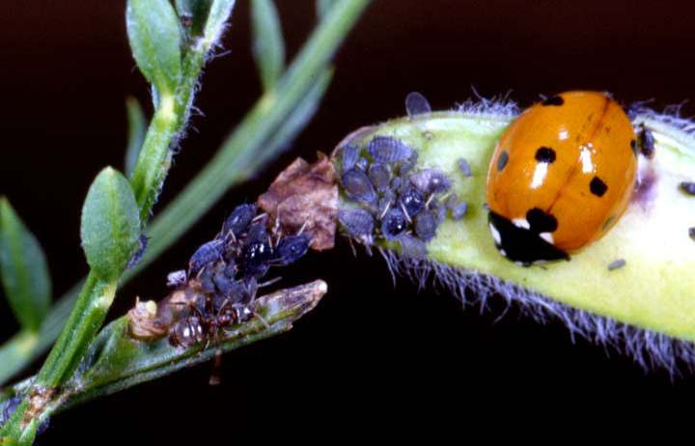
Community
A community means all the populations of different species that inhabit a certain area
7-spotted lady bird (Adephagia septempunctata)
Bean aphids(Aphis fabae)
Red ant (Myrmica rubra) and
Broom plant(Cytisus scoparius)

Slide 6
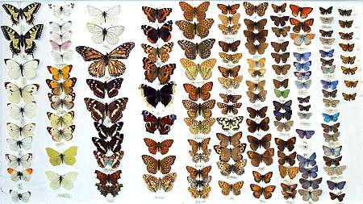
Biodiversity
Biodiversity, i.e. biological diversity, is the variety of living things in a given area.
Biodiversity can be defined in many different ways, such as in terms of genetic diversity or ecosystem diversity, but it is most often defined in terms of species diversity.
www.worcestercitymuseums.org.uk/.../bbox2.jpg

Slide 7
Biochemical Cycles
Biochemical cycles are complex cyclical transfers of nutrients from the environment to organisms and back to the environment.
Carbon, nitrogen and phosphorus cycles, for example.
Ecological Succession
Is defined as an orderly process of changes in community structure and function with time mediated through modifications in the physical environment and ultimately culminating in a stabilized ecosystem known as climax.
The whole sequence of communities which are transitory are known as seral stages or seres whereas the community establishing first of all in the area is called pioneer community.

Slide 8
ECOSYSTEM
The concept of ecosystem was first put forth by A.G. Tansley (1935).
Ecosystem is the major ecological unit.
It has both structure and function.
Ecosystem is a group of biotic communities of Interacting with one another and with their non living environment exchanging energy and matter.
Ecosystem consist of the living community and non- living factors of the environment.
It is therefore the totality of the system in which life proceed.
Ecosystem is equal to living community plus non-living factors of the environment.
Ecosystem refers to the smallest unit of the biosphere that has all the characteristics to sustain life. It can also be described as an assemblage of populations grouped into communities and interacting with each other and their local environment.
Ecosystem varies greatly with respect to size location, weather pattern and types of animal and plant that live there

Slide 9
Common to all ecosystems is a set of processes.
There are 2 important characteristics of ecosystem concept:
1. It can be applied at any scale example a drop of water inhabited by protozoa or mosquito or a forest estate. Ecosystem vary strictly with respect to size, location, weather pattern and types. The boundary of an ecosystem is not absolute because animals may wander from one region to another; seeds are blown by wind from one place to another.
2.There is reciprocity between living component of the ecosystem. The environment affects the organism as much as the organism affects the environment.

Slide 10
Structure of Ecosystem
ABIOTIC
Biotic
Temperature, Sunshine
Wind
Autotrophs Heterotrophs Decomposers
(green plants)
1 consumers 2consumers 3 consumers
(e.g. Goat) 1 carnivores 2 carnivores
(e.g. Dog) (eg Hyenna)

Slide 11
Components of the ecosystem
There are 2 basic elements in a given ecosystem
1. Living or biotic element
2. Non-living or abiotic element
Biotic component
Living parts of ecosystem can be sub-divided into
Autotrophs: - are the green plants which are the primary producers because they are able to convert the atmospheric sunlight through photosynthesis to manufacture their own food.
b) Heterotrophs: - they cannot synthesize their own food from sunlight and then depend on the primary producers (green plants). They are thus consumers. There are 3 levels of consumers:-
1. Primary consumers: - are the herbivores that feed directly on the primary producers. E.g Sheep, Goat.
2. Secondary consumers: - feed on the primary consumers. They are the carnivores e.g Dog, Cat.
3. Tertiary consumers:- are various carnivores that feeds on other carnivores e.g Hyena,
4. Decomposers: - These break down the producers and the consumers to micro part for reservation back into the systems e.g Microorganisms

Slide 12
Abiotic component
Comprises the non-living, in -animate parts called physical environment.
The physical and chemical components of an ecosystem constitute its abiotic structure.
It include
Climate (Temperature, Humidity, Rainfall, Sunshine, Wind and Evapotranspiration)
Geographical factors
Energy
Nutrients
Toxic substance

Slide 13
Physical factors
Sunlight and shade
Intensity of solar flux
Duration of sun hours
Latitude and altitude
Annual rainfall
Wind
Water availability
Water current
Soil type
Average temperature
Maximum and minimum temperature

Slide 14
Chemical factors
Carbon
Nitrogen
Phosphorus
Potassium
Hydrogen
Oxygen
Levels of toxic substances
Salt causing salinity
Sulphur
Various organic substance present in the soil or water largely influenced the functioning of the ecosystem.

Slide 15
Functional Attributes
Food chain
Food web
Energy flow
Biogeochemical cycle
Primary and secondary production
Ecosystem development and regulation

Slide 16
Food Chains
The sequence of eating and being eaten is known as food chain
The producers, consumers, and decomposers of each ecosystem make up a food chain
The producers and consumers are arranged in the ecosystem in a definite manner and their interaction along with population size are expressed together as trophic structure
Each level is known as a trophic level at a given time
The amount of living matter at each trophic level is known as standing crop or standing biomass
There are many food chains in an ecosystem

Slide 17
In each transfer some energy is lost .
Therefore the shorter the food chain the greater the energy available to that population.
Food chains are of two basic types:
1. THE GRAZING FOOD CHAIN
This type of food chain starts from the green plant which goes to grazing herbivores and on carnivores
Grass……….Grasshopper………Frog………..Snake…….Hawk
2. THE DETRITUS (ERODED) FOOD CHAIN
It starts with dead organic matter which the detritivores and decomposers consume. Partially decomposed organic matter and even the decomposers are consumed by detritivores and their predators. An example of the detritus food chain is seen in a Mangrove estuary.

Slide 18
A large quantity of leaf material falls in the form of litter into water. The leaf fragments are eaten by saprotrophs
Saprotrophs are those organisms which feeds on dead organic matter
These fallen leaves are colonized by small algae , which are also consumed by the saprotrophs or detritivores consisting of small crabs , mollusks, shrimps ,insects larvae , nematodes and fishes
These detritivores are eaten by large carnivorous fishes
Leaf litter……algae….crabs…..small carnivorous fish……..…large carnivorous fish (Mangrove ecosystem)

Slide 19
Dead organic matter……fungi…..bacteria (Forest ecosystem) thus the grazing food chain derives its energy basically from plant. While in detritus food chain it is obtained from plant biomass, secondarily from microbial biomass and tertiarily from carnivores
Both the food chains occur together in natural ecosystem, but grazing food chain usually predominates

Slide 20
Characteristics of food chain
In a food chain, there is repeated eating in which each group eats the smaller one and is eaten by the larger one
In a food chain there is unidirectional flow of energy from sun to producer and then series of consumers
Usually 80-90% of potential energy is lost as a heat at each transfer
Usually there are 4-5 trophic levels in the food chain, shorter food chain will provided greater energy
A food chain is always straight
Omnivores generally occupy more than 1 trophic level in a food chain

Slide 21
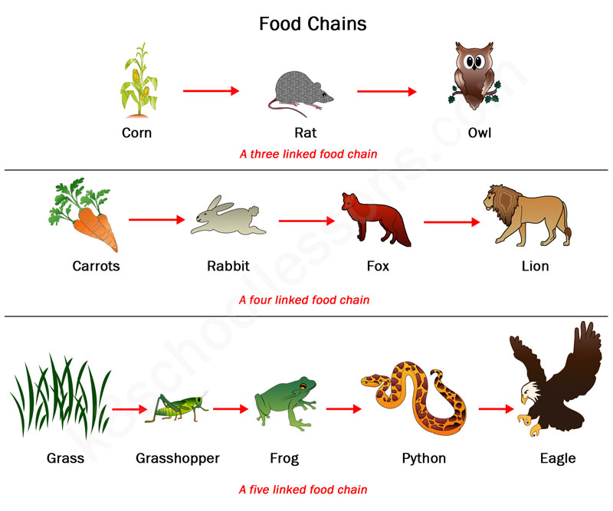

Slide 22
Food web : Interlocking pattern of organisms
Food web is the network of food chains where different types of organisms are connected at different trophic levels ,so that option of eating and being eaten at each trophic level
Food chains in natural conditions never operate as isolated sequences, but are interconnected with each other forming interlocking pattern, which is referred to as a food web
Under natural conditions, the linear arrangement of food chains hardly occurs and these remain indeed interconnected with each other through different types of organisms at different trophic levels.
For example, in grazing food chain of grassland, in the absence of rabbit, grass may also be eaten by mouse. The mouse in turn may be eaten directly by hawk or by snake first which is then eaten by hawk. Thus, in nature there are found alternatives which all together constitute some sort of interlocking pattern and are called the food web.

Slide 23
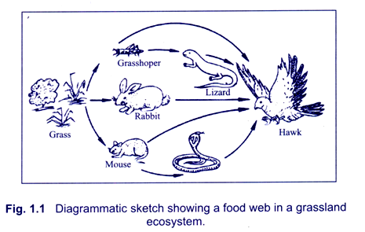
https://www.yourarticlelibrary.com/environment/ecosystem/food-webs-useful-notes-on-food-webs-with-diagram/27315

Slide 24
There may be seen five possible food chains interlocked together making the food web. Besides those shown in Figure 1.1, there may also be present some other consumers as vultures, fox and man in grasslands, and if so, the food web may be even more complex than shown in the figure
Grass………. Grasshopper……..hawk
Grass………..Grasshopper……...Lizard…..Hawk
Grass………..Mouse……Hawk
Grass………...Mouse…..Snake……Hawk
However, these all five chains are interlinked with each other at different points, forming food web. Real food webs usually have hundreds of species interlinked by their feeding habits. Food webs are basic units of ecosystem ecology.

Slide 25
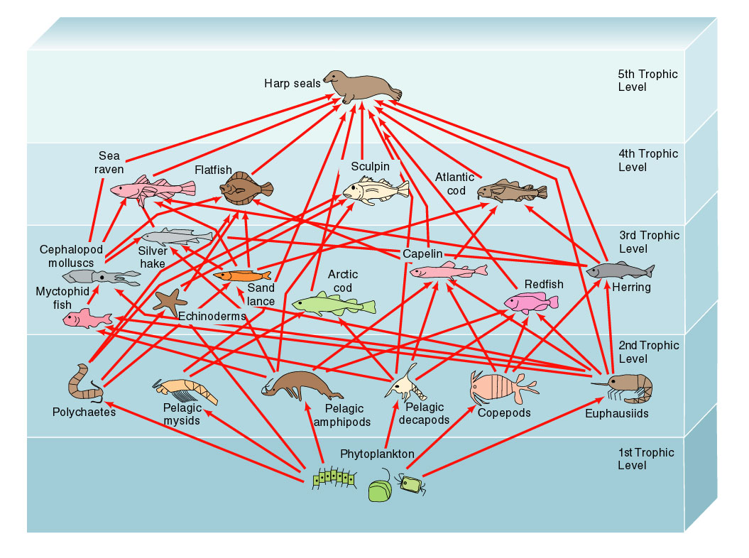
Food web

Slide 26
Significance of food web
The food web provides alternate pathways of food availability
e.g. if particular crop is destroyed due to some disease ,the herbivores in that area do not perish as these can graze on other types of crop or herbs .greater the no of these alternate pathways more stable is the ecosystem
These also help in checking over population of highly fecundity species of plants and animals .
Food webs also help in ecosystem development

Slide 27
Ecological Pyramids
An ecological pyramid (also trophic pyramid or energy pyramid) is a graphical representation of trophic structure and function of an ecosystem, starting with producer at base and successive trophic levels forming the apex.
Term Ecological Pyramids coined by Charles Elton
TYPES OF ECOLOGICAL PYRAMID
Pyramid of Number
Pyramid of Biomass
Pyramid of Energy

Slide 28
Pyramid of number
A pyramid of numbers is a graphical representation of the numbers of individuals in each population in a food chain. Often it is drawn from the autotrophic level up.
A pyramid of numbers can be used to examine how the population of a certain species affects another.
Often, the autotrophic level in a pyramid of numbers is much larger than any of the higher trophic levels, and the numbers decreases upon ascending the pyramid.
There are exceptions, however for example, in a tree community, a single tree could support many different populations of larger numbers.

Slide 29
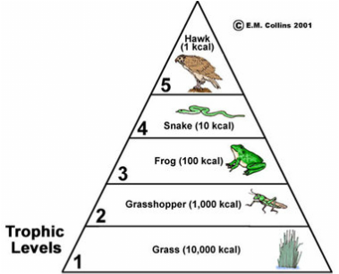
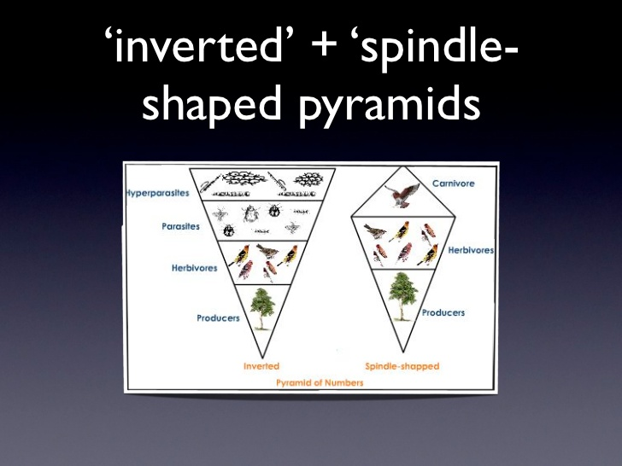
Grassland ecosystem
Parasitic Food chain
Forest ecosystem

Slide 30
Pyramid of Biomass
Illustrates the amount of biomass in each trophic level
Biomass weight is determined after dehydration
Shows the amount of matter lost between trophic levels.
Measured in Kg, grams or pounds

Slide 31
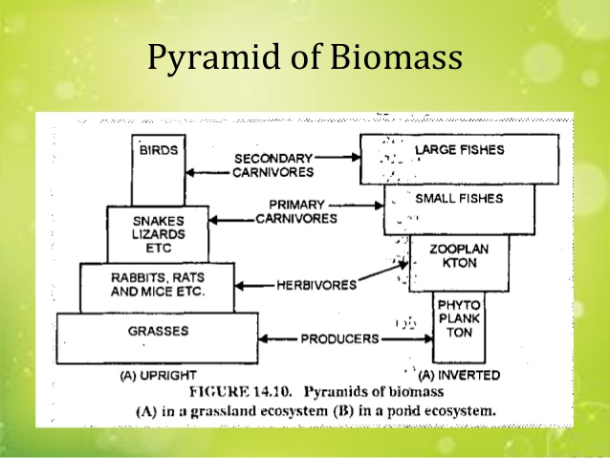

Slide 32
Pyramid of Energy
Shows the energy available at each trophic level.
The size of the blocks represents the proportion of productivity.
Measured in Joules or Calories

Slide 33
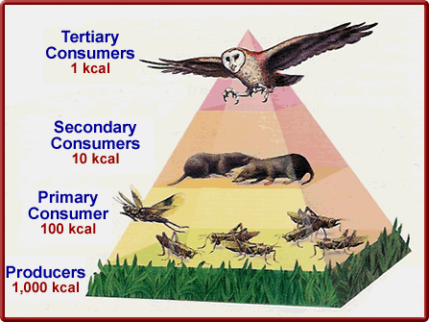

Slide 34
Ecological Succession
Is defined as an orderly process of changes in community structure and function with time mediated through modifications in the physical environment and ultimately culminating in a stabilized ecosystem known as climax.
The whole sequence of communities which are transitory are known as seral stages or seres whereas the community establishing first of all in the area is called pioneer community.

Slide 35
Characteristics of ecological succession
A continuous change in the kinds of animals and plants towards stability .
Increase in the species diversity
In an area , the plant and animals communities undergoes succession.
Biotic succession on a bare ground progress towards increasing wetness, while biotic succession in open water progress towards increasing dryness
An increase in the organic matter and biomass

Slide 36
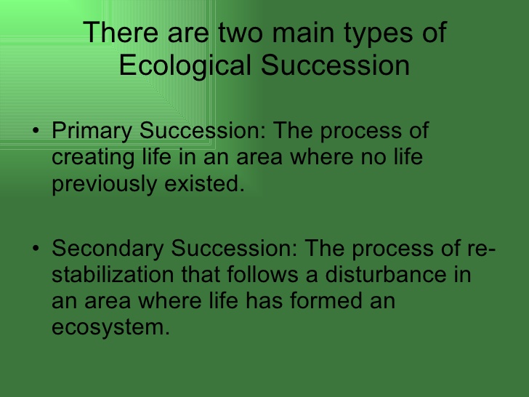

Slide 37
On basis of different substrata ecological succession
Hydrosere (water)
Mesosere (moderate moisture)
Xerosere (dry area with little moisture)

Slide 38
Xerosere
Lithosere ( rocky surface)
Psammosere (coastal soil)
Halosere (saline soil)

Slide 39
Process
Nudation
Invasion
Competition and coaction
Reaction
Stabilization

Slide 40
Nudation : it is the development of a bare area without any life form
The bare area may be caused due to landslides, volcanic eruption etc or due to drought, glaciers, frost etc or due to overgrazing ,disease outbreak, agricultural/ industrial activities
Invasion : it is the successful establishment of one or more species on a bare area through dispersal or migration followed by ecesis or establishment. Dispersal of the seed , spores etc is brought about by wind, water , insect or birds. Then the seeds germinate and grow on the land. As growth and reproduction start, these pioneer species increase in number and form group or aggregation.
Competition and coaction: As the number of individuals grows there is competition , both inter specific and intraspecific for space , water and nutrition. They influence each other in a number of ways known as coaction.

Slide 41
Reaction: The living organisms grow , use water and nutrients from the substratum , and in turn , they have strong influence on the environment which is modified to a large extent and this known as reaction. The modifications are very often such that they become unsuitable for the existing species and favor some new species , which replace them. Thus, reaction leads to several seral communities.
Stabilization: The succession ultimately culminates in a more or less. Stable community called climax which is in equilibrium with the environment
The climax community is characterized by maximum biomass and symbiotic (mutually beneficial) linkages between organisms and are maintained quite efficiently per unit available energy.

Slide 42
Hydrosere
Free floating stage (pioneer )
Rooted floating stage
Reed swamp stage
Sedge meadow stage
Woodland stage
Forest (climax)

Slide 43
Xerosere
Lichen ( pioneer)
Mosses
Herbs
Shrubs
Forest ( climax)

Slide 44
This type of succession starts on bare rocks , which lacks water and organic matter.
The pioneer community here is crustose and foliose lichens .
These lichens produce some weak acid and help in disintegrating the rock ,known as weathering.
Their growth help in building up gradually some organic matter, humus and soil.
Then comes the community of mosses, followed by herbs , shrubs and finally the forest trees
Throughout this gradual process there is slow build of organic matter and water in the substratum
Thus succession tends to move towards mesic conditions (moderate condition) irrespective of the fact, whether in started from dry ( xeric ) condition or a moist ( hydric) condition and it culminates in a stable climax community , which is usually a forest.

Slide 45
Energy flow in an ecosystem
Energy flow is the key function of an ecosystem .
There is unidirectional flow of energy.
During each transfer 80-90% energy is lost in a form of heat in metabolic reaction e.g. respiration and excretion.
10-20% of energy is available in next trophic level.
There is corresponding decrease in biomass
Energy follows 1st and 2nd law of thermodynamics

Slide 46
First law of thermodynamics
Energy can neither be created nor be destroyed it can be converted
from one form to another form.
Second law of thermodynamics
Every Energy transformation involves dissipation or degradation of energy from concentrated to dispersed form due to metabolic functions ,So that only part of energy is stored in the biomass

Slide 47
Lindeman’s Energy flow model
Solar radiation (118872)
Decomposition 3.0
Decomposition 0.5
Decomposition (Trace)
Herbivores
(G.P/15)
Carnivores
(G.P/3.0)
Autotrophs
Gross production
(G.P/111)
Not utilized 1.2
Respiration 23
Not utilized 70
Not utilized 7
Respiration 1.8
Respiration 4.5

Slide 48
Producers can utilize only 0.1 % (111.0 gcal/cm2 /yr out of 118,872 g.al./cm2/year) of incident solar radiation in their primary gross production or total photosynthesis
Out of this gross production, about 21% is consumed in metabolic functions of the autotrophs e.g respiration, growth and reproduction; 63% remains unutilized and about 3% is utilized in the process of decomposition so that only 13-14% (i.e. 15g.cal./cm2/year)of P_{G} is available to the herbivores
At herbivores, out of 15 g. cal./cm2/year, about 30% is utilized in metabolic reaction ( even more than autotrophs); 47% of energy available unutilized and 3% of it is utilized in decomposition so that only 20% energy of autotrophs is utilized in secondary net production of primary carnivores
Process is repeated during transfer of energy from the primary to secondary carnivores and so on

Slide 49
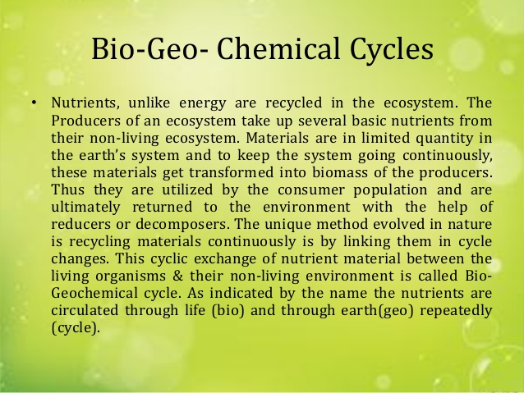

Slide 50
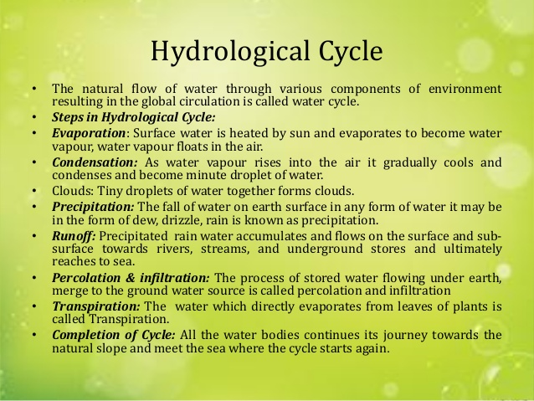

Slide 51
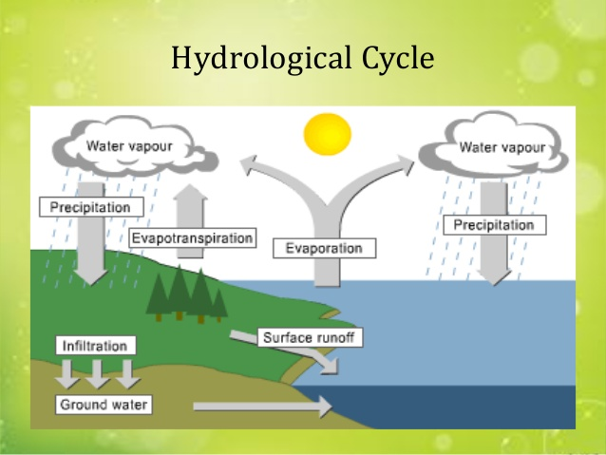

Slide 52
The Carbon Cycle
Carbon-based organic molecules are essential to all organisms
Photosynthetic organisms convert CO₂ to organic molecules that are used by heterotrophs
Carbon reservoirs include fossil fuels, soils and sediments, solutes in oceans, plant and animal biomass, the atmosphere, and sedimentary rocks
CO₂ is taken up and released through photosynthesis and respiration
Volcanoes and the burning of fossil fuels also contribute CO₂ to the atmosphere

Slide 53
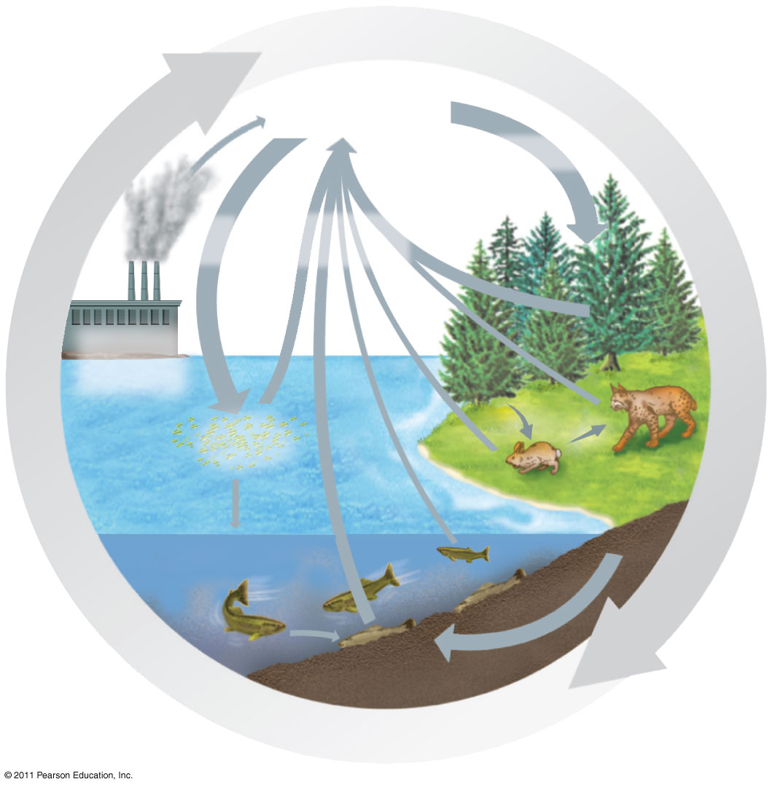
CO₂ in
atmosphere
Photosynthesis
Photo-
synthesis
Cellular
respiration
Burning
of fossil
fuels and
wood
Phyto-
plankton
Consumers
Consumers
Decomposition

Slide 54
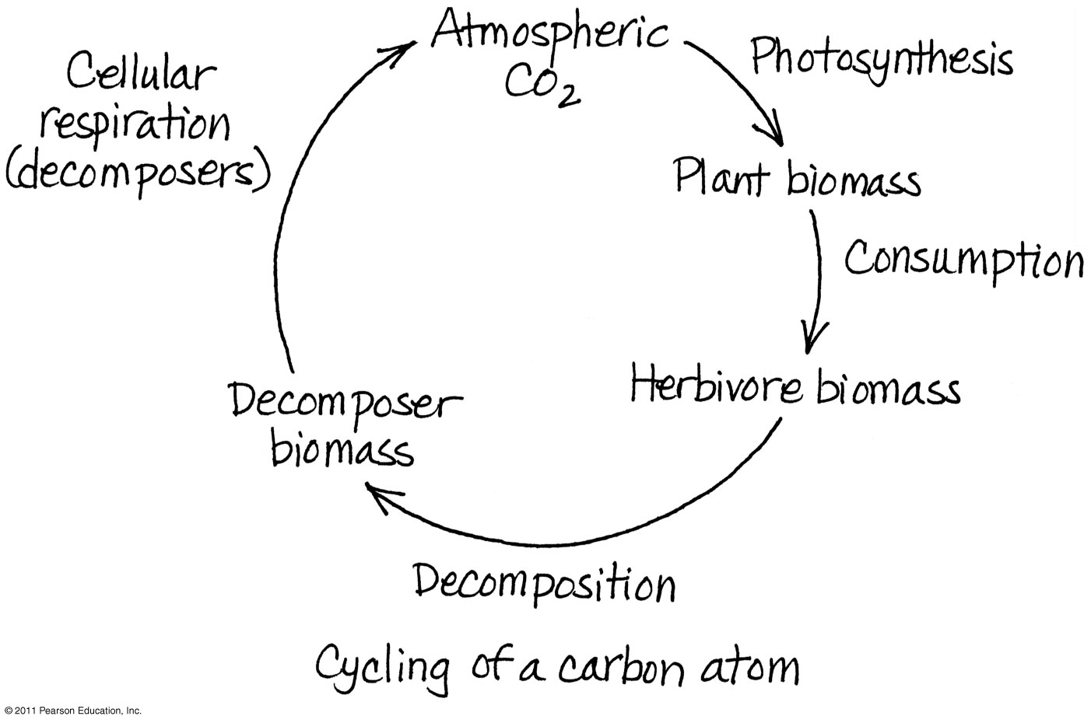

Slide 55
Primary productivity of an ecosystem is defined as the rate at which radiant energy is converted into organic substances by photosynthesis or chemo-synthesis by the primary producers.
When organic matter is produced by the primary producers (mainly green plants and some microorganisms), some of it is oxidized or burnt inside their body and converted into carbon-dioxide which is released during respiration and is accompanied by loss of energy.
Respiratory loss of energy is a must, because it is required for the maintenance of the organism. Now, the producers are left with a little less organic matter than what was actually produced by them. This is known as the net primary production (NPP) and the respiratory loss (R) added to it gives the gross primary production (GPP). Thus, NPP = GPP – R
Primary production of an ecosystem depends upon the
solar radiations,
availability of water and nutrients and upon the type of the plants and
their chlorophyll content
Productivity of tropical forests and estuaries are the highest. This is because tropical forests have abundant rainfall, warm temperature congenial for growth, abundant sunlight and a rich diversity of species.

Slide 56
Estuaries get natural energy subsidies in the form of wave currents that bring along with them nutrients required for production
Deserts on the other hand, have limitations of adequate water supply while Tundra have very low temperature as limiting factor and hence show low primary production.
Agro-ecosystems get lots of energy subsidies in the form of irrigation water, good quality seeds, fertilizers and pesticides and show a high productivity of 12,000 K Cal/m2/yr. Still, it is noteworthy that their productivity is less than that of tropical forests which are not receiving any artificial energy subsidies.
Nature itself has designed its species composition, structure, energy capture and flow, and a closed nutrient cycling system that ensures a high primary production of 20,000 K Cal/m2/yr.
Also, the qualitative variety of the primary production is enormous in the tropical forests. This makes it all the more important to conserve our tropical forests.

Slide 57
Secondary Production
The food synthesized by green plants through photosynthesis is the primary production which is eaten by herbivores.
The plant energy is used up for producing organic matter of the herbivores which, in turn, is used up by the carnivores.
The amount of organic matter stored by the herbivores or carnivores (in excess of respiratory loss) is known as
secondary production. The energy stored at consumer level for use by the next trophic level is thus defined as secondary production

